Slide 1
Grow by even Spread
Karl Kraus

Slide 2
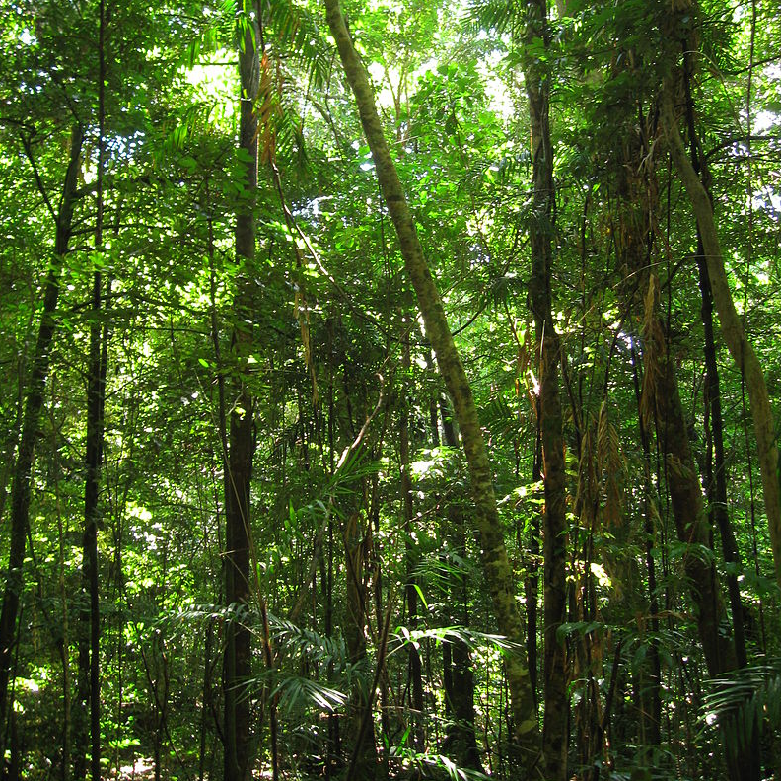
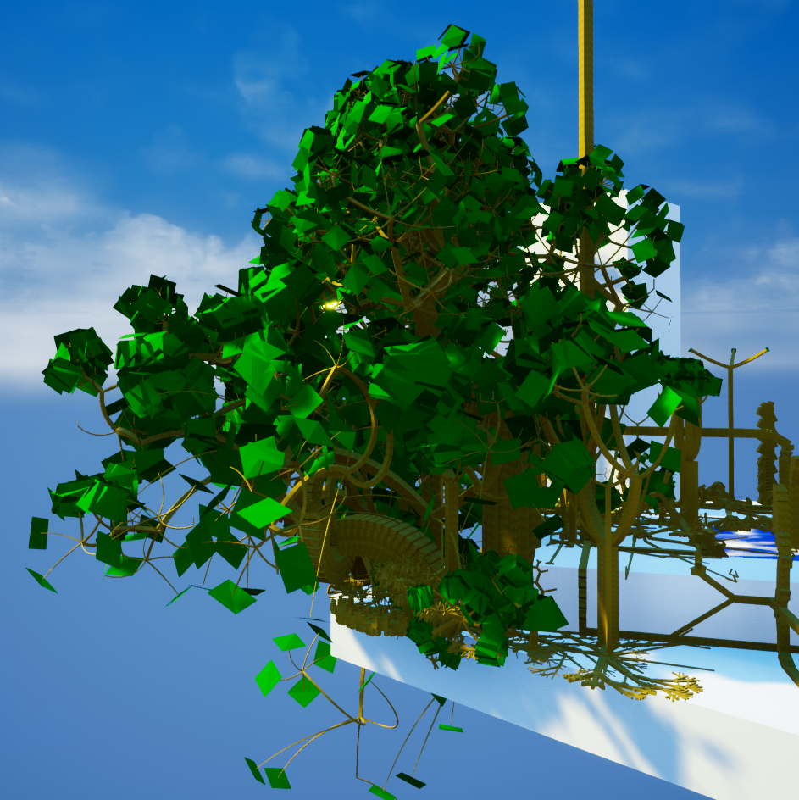
Biological Trees and Trees Generated by our Algorithm

Slide 3
Outline
Related work
Fundamental ideas
Features and simulated environmental influences
Results and behavior of the system

Slide 4
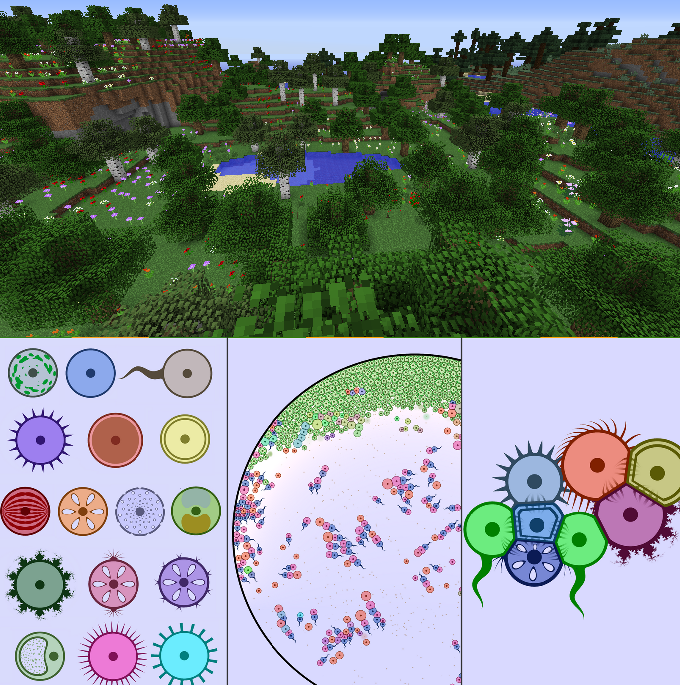
Related Work: Simulated Ecosystems
Many games have design elements with some sort of ecological influence
Yet they usually recreate high-level behavior by description
Instead, we will try to set low level rules with many degrees of freedom
Real-life-similar behavior should emerge from these basic rules
Top: Minecraft; Bottom: CellLab

Slide 5
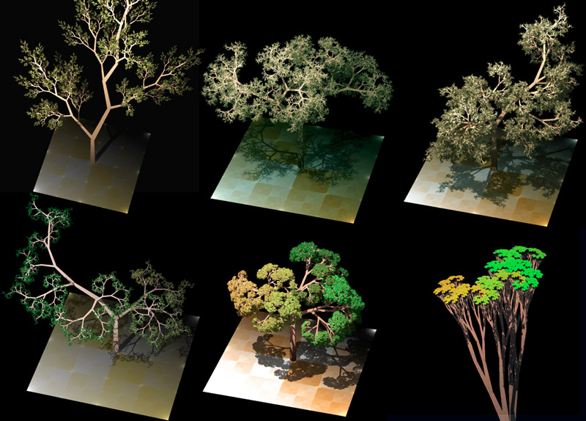
Related Work: Procedural Plant Generation
Procedural plant generation has great commercial relevance (SpeedTree)
State of the art for generation are Lindenmayer-Systems
L-Systems are formally defined as a string-manipulating system
With the aid of simple drawing rules, they can excellently express self-similarity
Thus, impressive results can be achieved (figure)
L-Systems are unfit for low-level randoming, and interactions of different organisms based on 3D Space

Slide 6
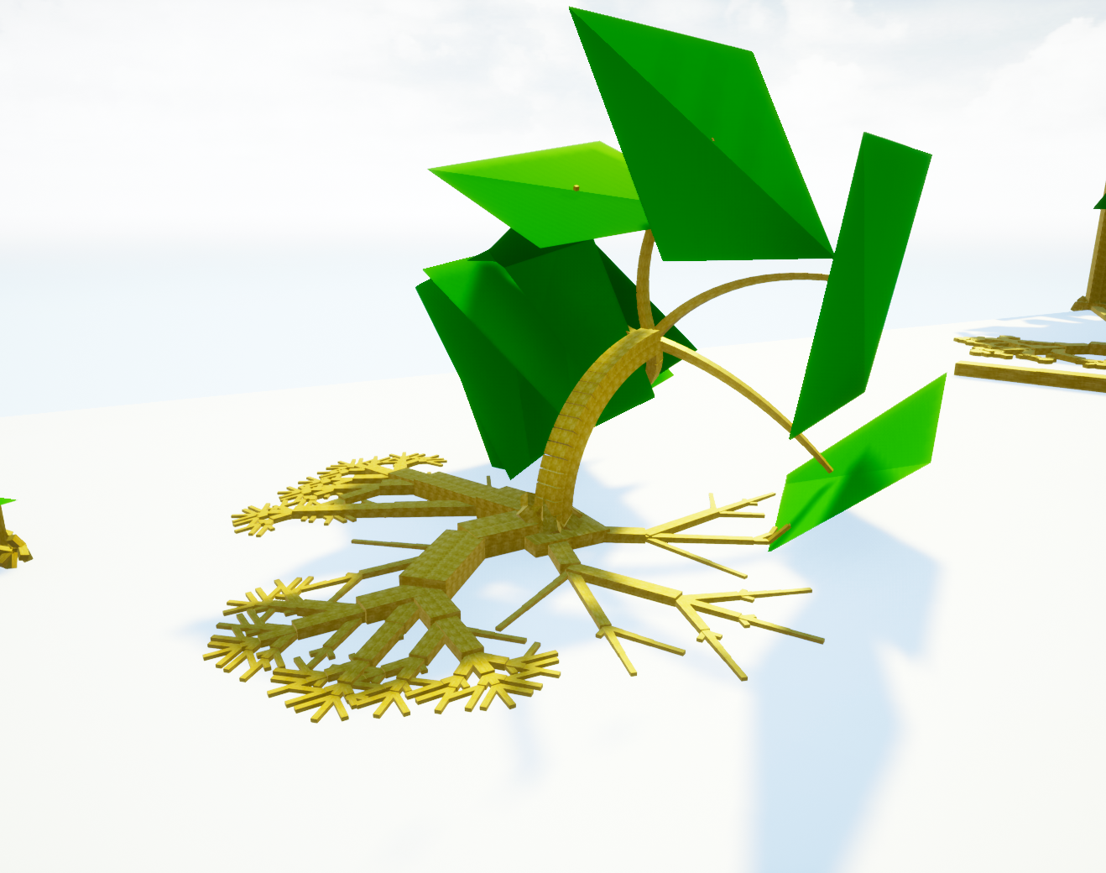
Fundamental Ideas
L-Systems gave the initial idea, but the formal constraints of those were dropped
Basis of the simulation are cells with certain properties and their 3D-representation
Cells have types (e.g., “leaf”)
Basis of growth is the division of cells into cells of the same or different type
Every cell (except the root) has an “attachement parent”, and the childs position is calculated relative to the parent

Slide 7
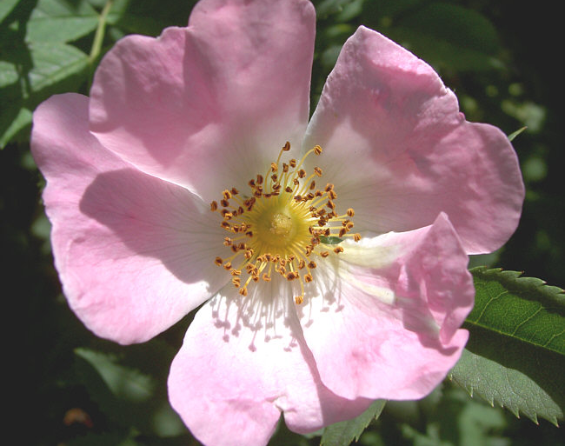
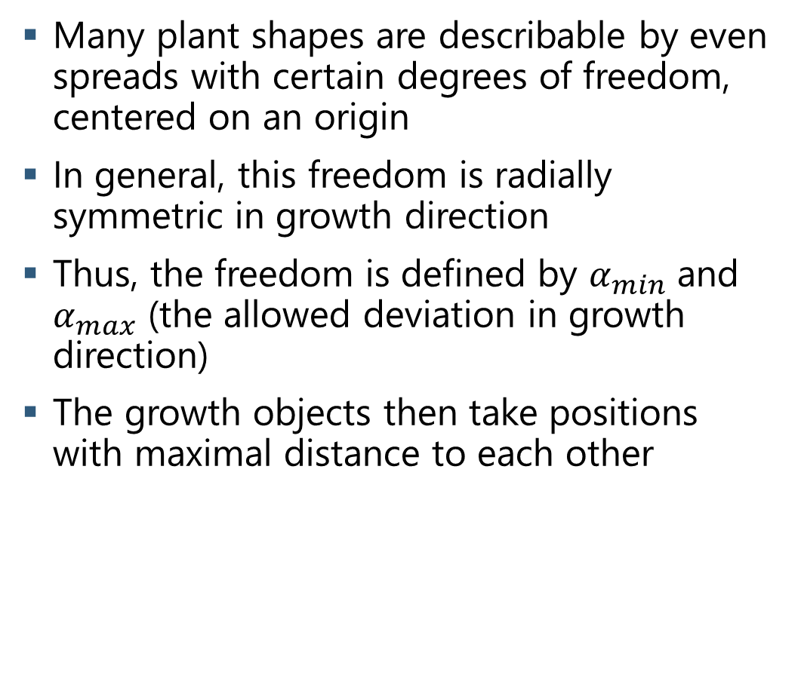
Even Spread and Self-Similarity I
Many plant shapes are describable by even spreads with certain degrees of freedom, centered on an origin
In general, this freedom is radially symmetric in growth direction
Thus, the freedom is defined by $α_{min}$ and $α_{max}$ (the allowed deviation in growth direction)
The growth objects then take positions with maximal distance to each other
Different Even Spreads in Blossom

Slide 8
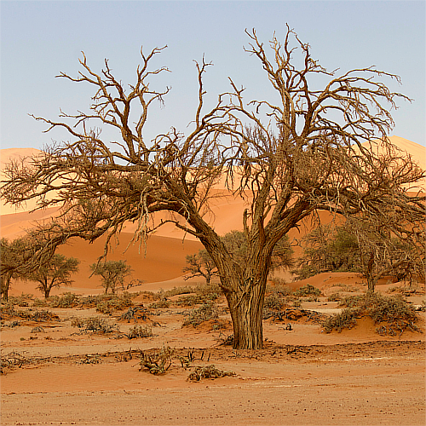
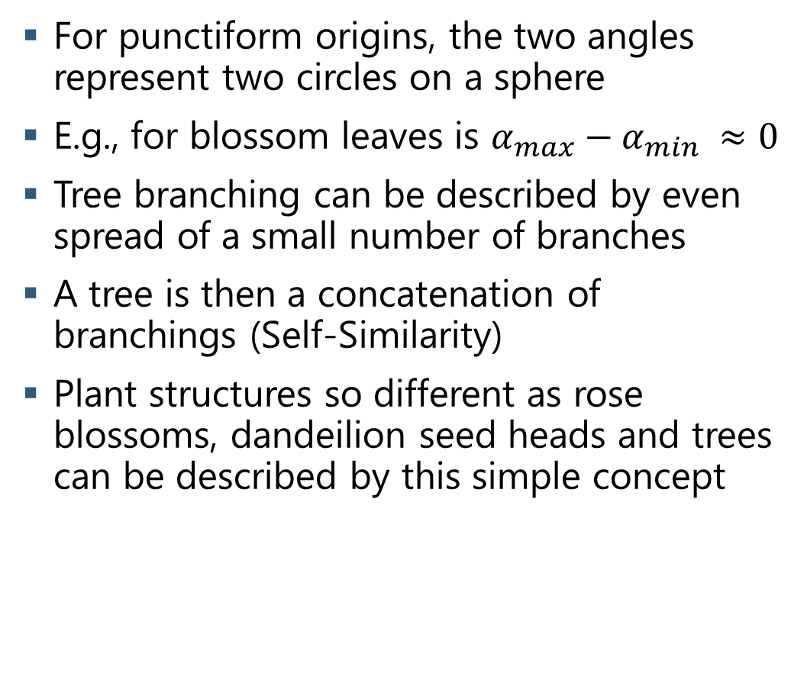
Even Spread and Self-Similarity II
For punctiform origins, the two angles represent two circles on a sphere
E.g., for blossom leaves is $α_{max}−α_{min} ≈0$
Tree branching can be described by even spread of a small number of branches
A tree is then a concatenation of branchings (Self-Similarity)
Plant structures so different as rose blossoms, dandeilion seed heads and trees can be described by this simple concept

Slide 9
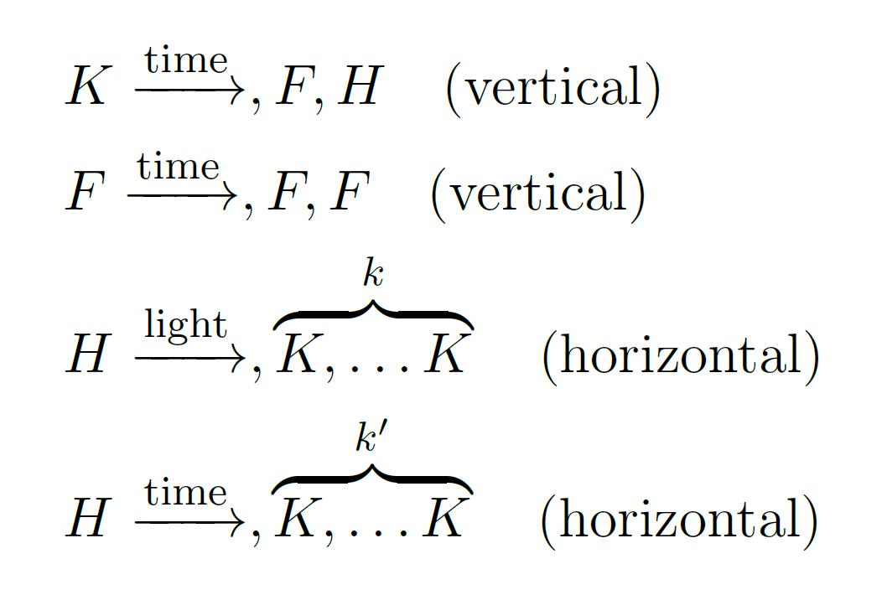
Division Rules

Slide 10
Division Rules
Vertical division means „straigth“ growth into a branch
Multiple F states, so that plants grow faster at the “tip”

Slide 11
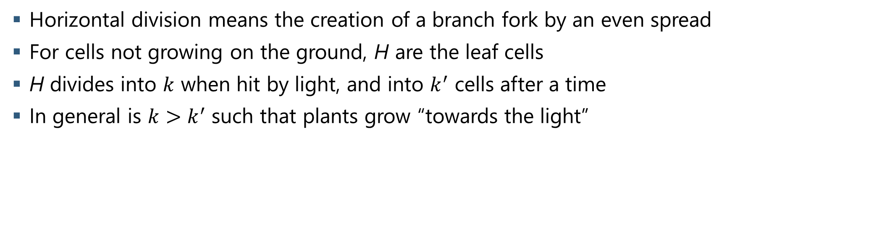
Division Rules
Horizontal division means the creation of a branch fork by an even spread
For cells not growing on the ground, H are the leaf cells
H divides into $k$ when hit by light, and into $k^{′}$ cells after a time
In general is $k>k^{′}$ such that plants grow “towards the light”

Slide 12
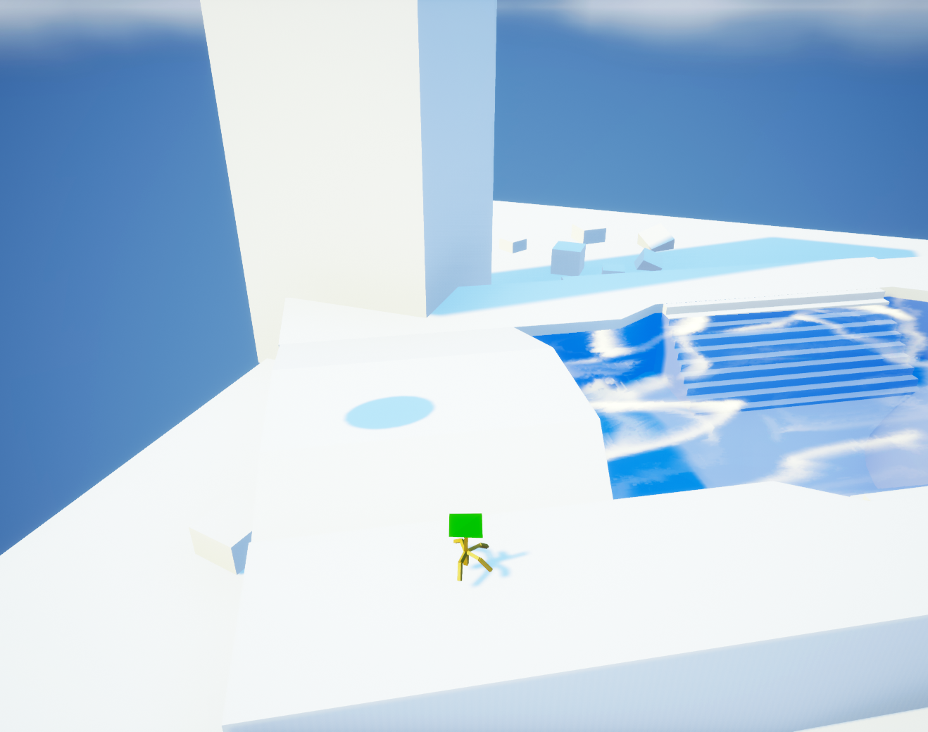
Plant Growth Example
5 Iterations
5 Iterations

Slide 13
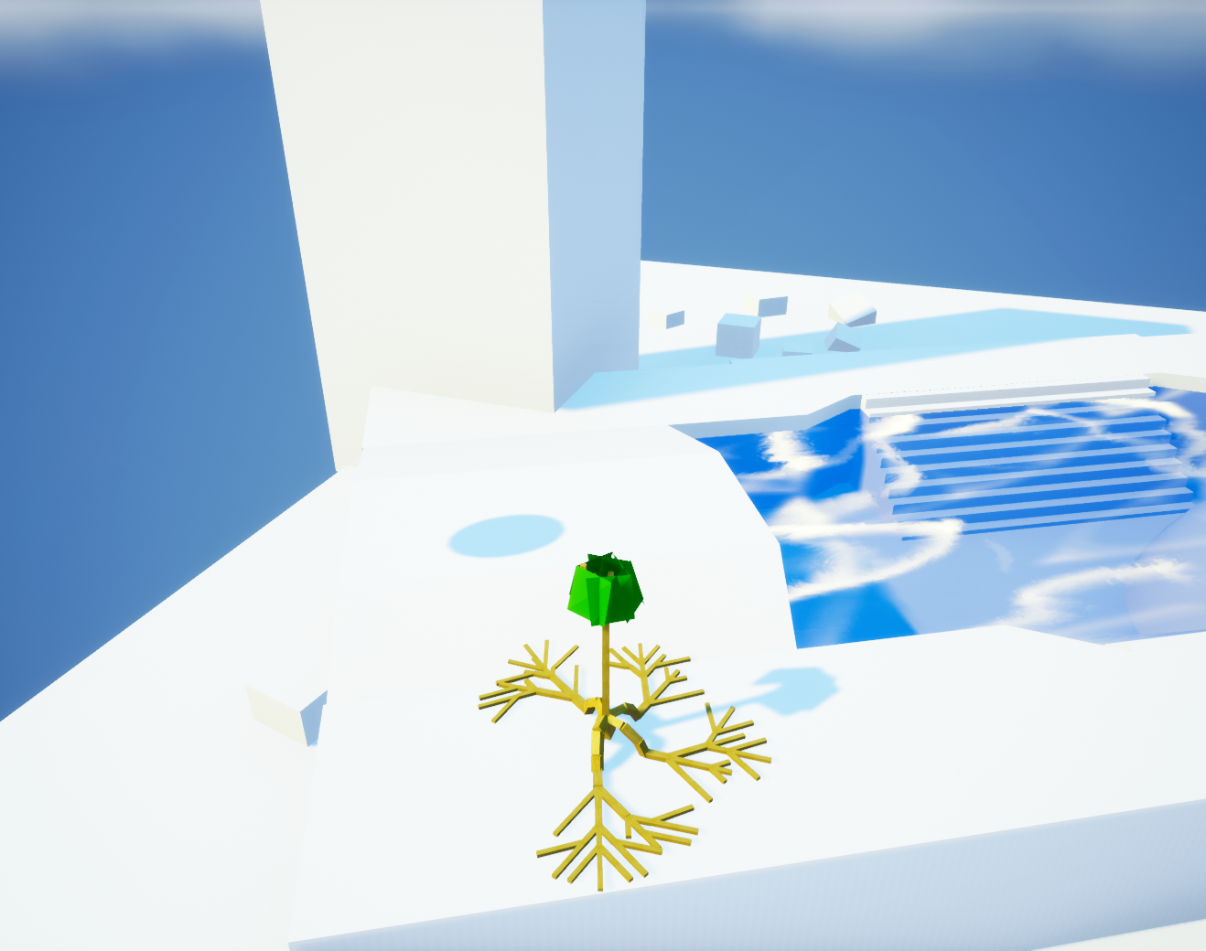
Plant Growth Example
20 Iterations
20 Iterations

Slide 14
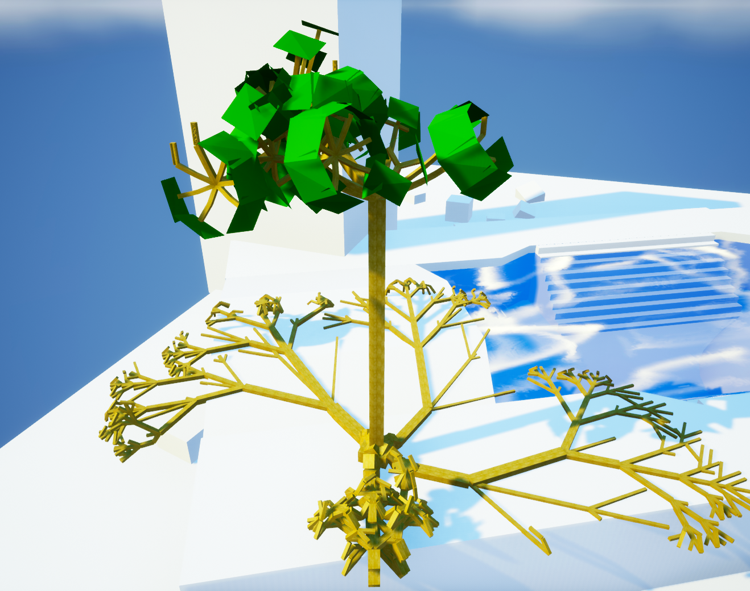
Plant Growth Example
35 Iterations
35 Iterations

Slide 15
Modelled Behaviors
Plants cannot grow into obstacles
Plants grow towards light
Water promotes tree growth
Cells that carry more have a higher diameter
Growth can be influenced by gravity
Roots grow attached to the ground
Wind/Storm destroys parts of plants

Slide 16
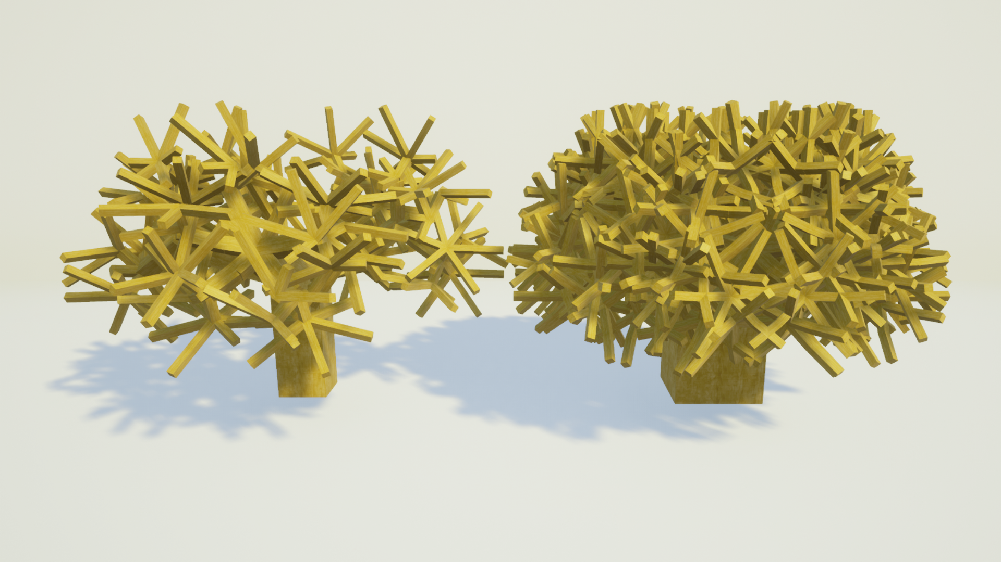
Self-Collision
Left: self-collision disabled; Right: Self-collision disabled
In reality, branches cannot overlap
Cells without children check for possbile collisions, and do not divide if one is found
This greatly reduces, but does not completely prevent collisions
This also adds deterministic, yet seemingly unpredictable structure

Slide 17
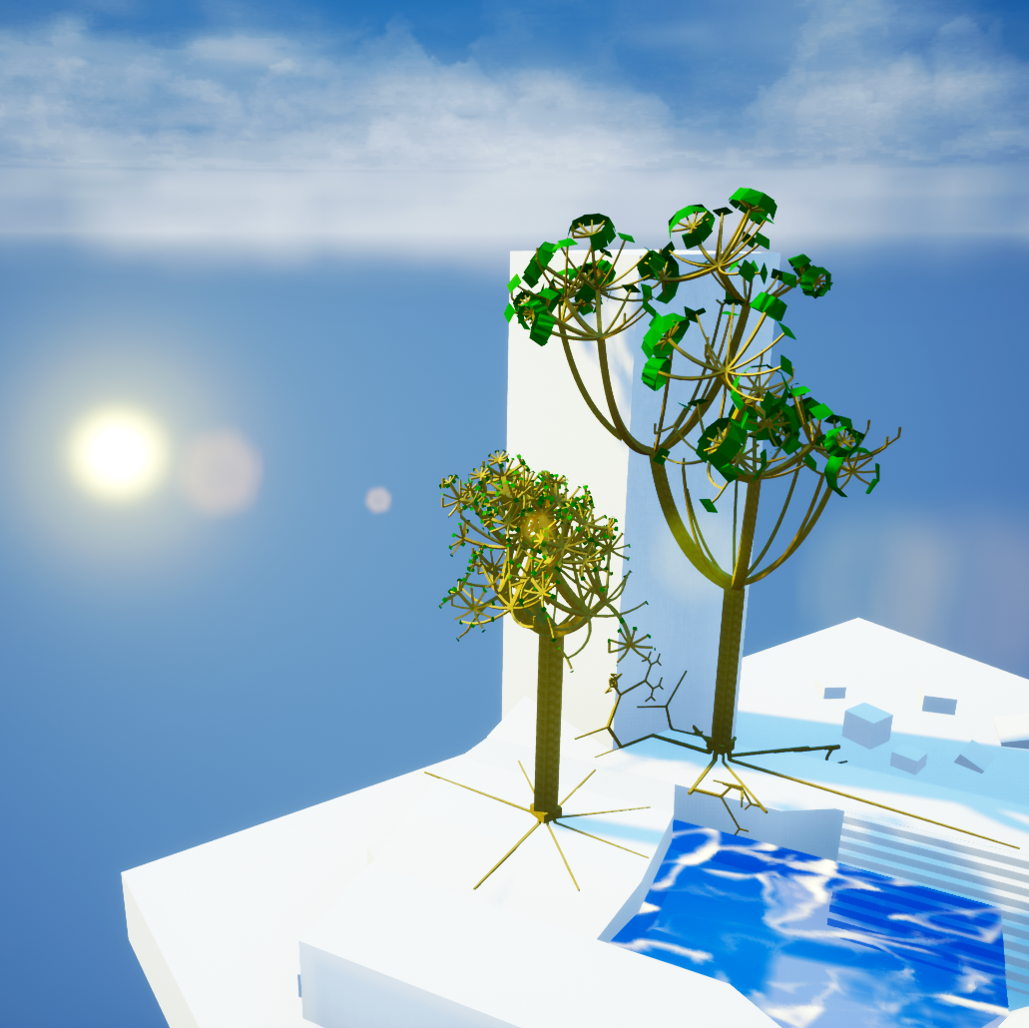
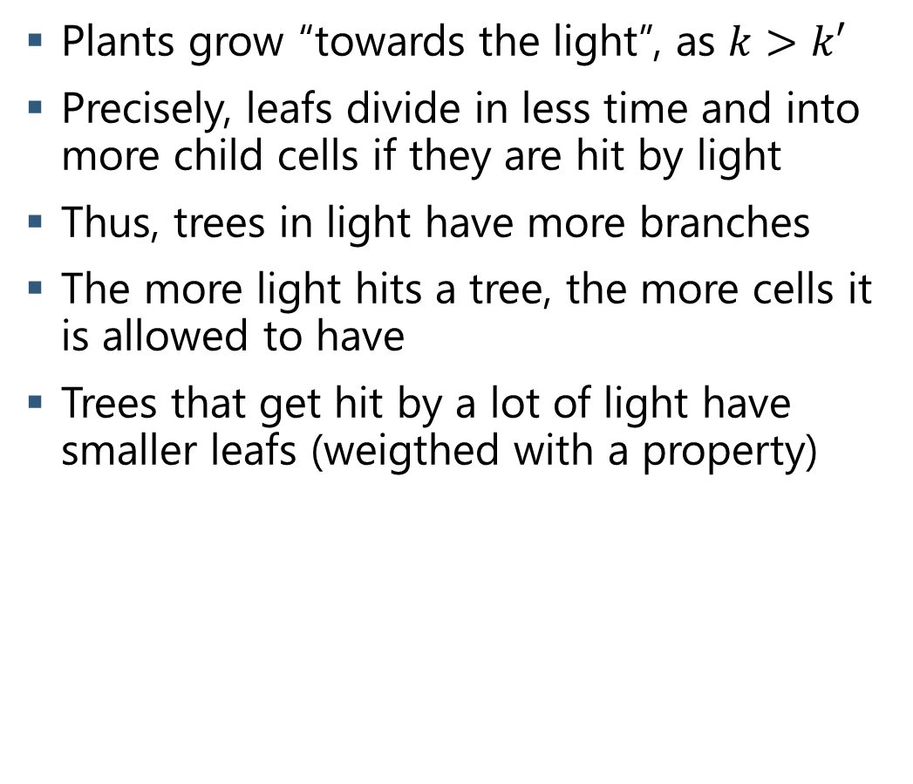
Growth to Light
Plants grow “towards the light”, as $k>k′$
Precisely, leafs divide in less time and into more child cells if they are hit by light
Thus, trees in light have more branches
The more light hits a tree, the more cells it is allowed to have
Trees that get hit by a lot of light have smaller leafs (weigthed with a property)
Identical Tree In Light and Penumbra

Slide 18
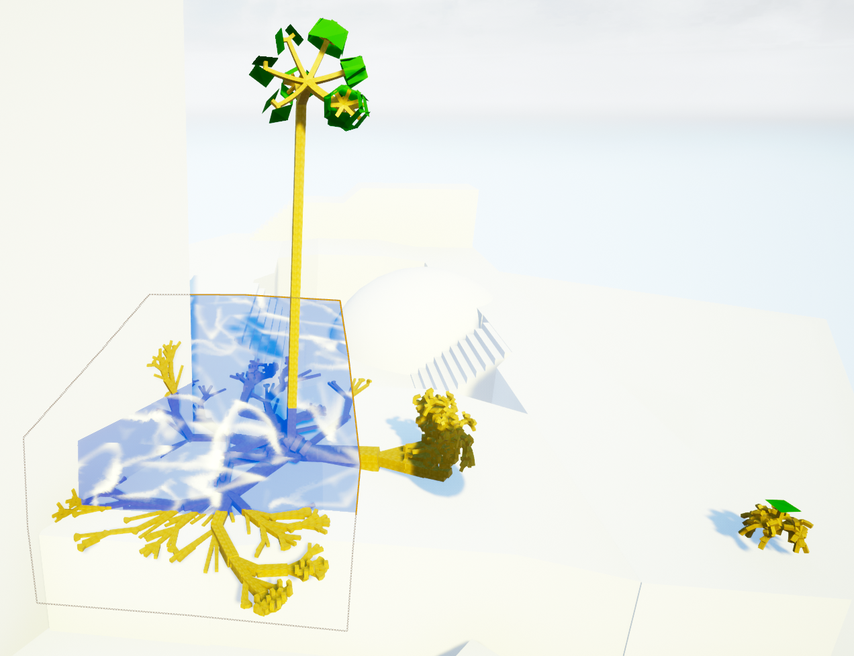
Influence of Water
The plant in the water grows way more than the other one
Distance to light source similar, propertie/”genes” identical
Water is not necessary, but promotes growth to diversify the vegetation
Plants check every iteration how many cells overlap water, and thereby raise the allowed total amount of cells

Slide 19
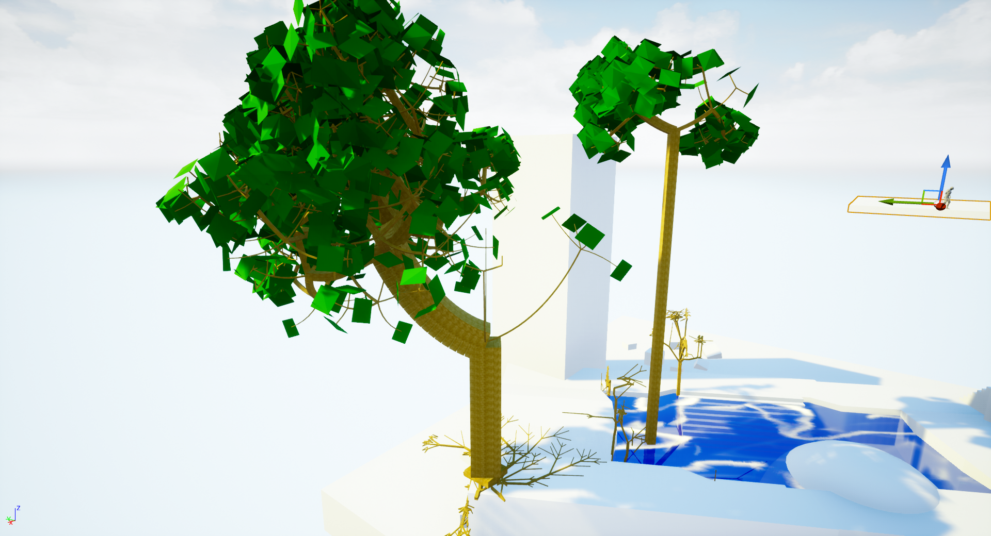
Cell Diameter Growth
Real life trees are bigger where they have to carry a lot of weight (e.g., at the trunk)
Cell diameter raises with the number of “attachement descendants” they have
The two property-identical trees visualize the difference in growth shape of trees in water
Also, they are an example for positive correlation with gravity

Slide 20
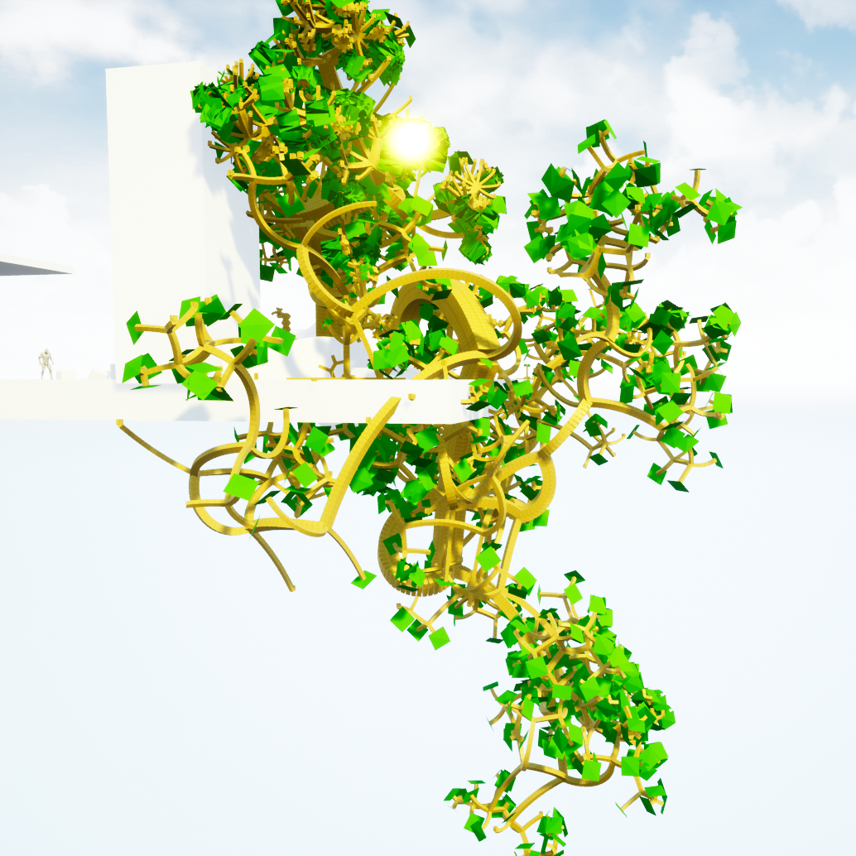
Influence of Gravity
Negative correlation with gravity leads to trees “bending over”
Many plants, e.g. palms, ferns and willows, show this behavior
The twisted structure of the shown plant emerges as a combination of downward growth and horizontal cell division
This is also especially prone to provoke mistakes in collision detection

Slide 21
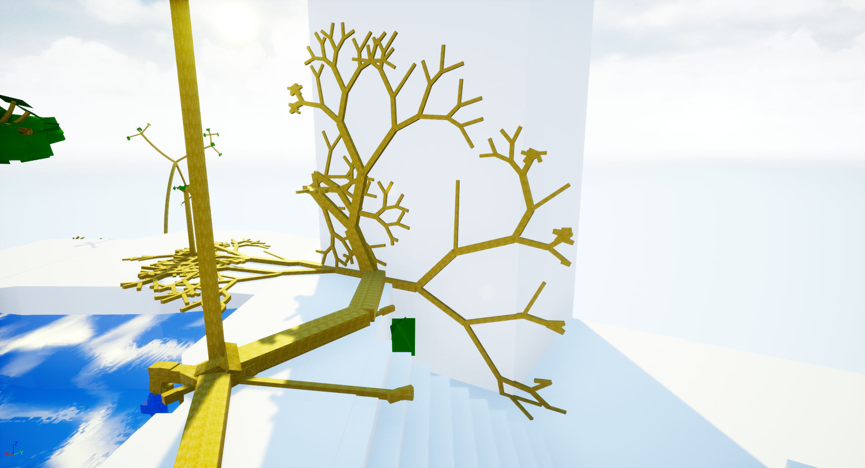
Growth in the Plane
Roots are an integral part of plants, visually and biologically
Simulating growth in the earth is complicated, and not visually interesting
Thus, roots grow in a plane (the ground) which even spread is limited to
If roots hit an obstacle, a new plane is calculated
The system can also be used to represent vines

Slide 22
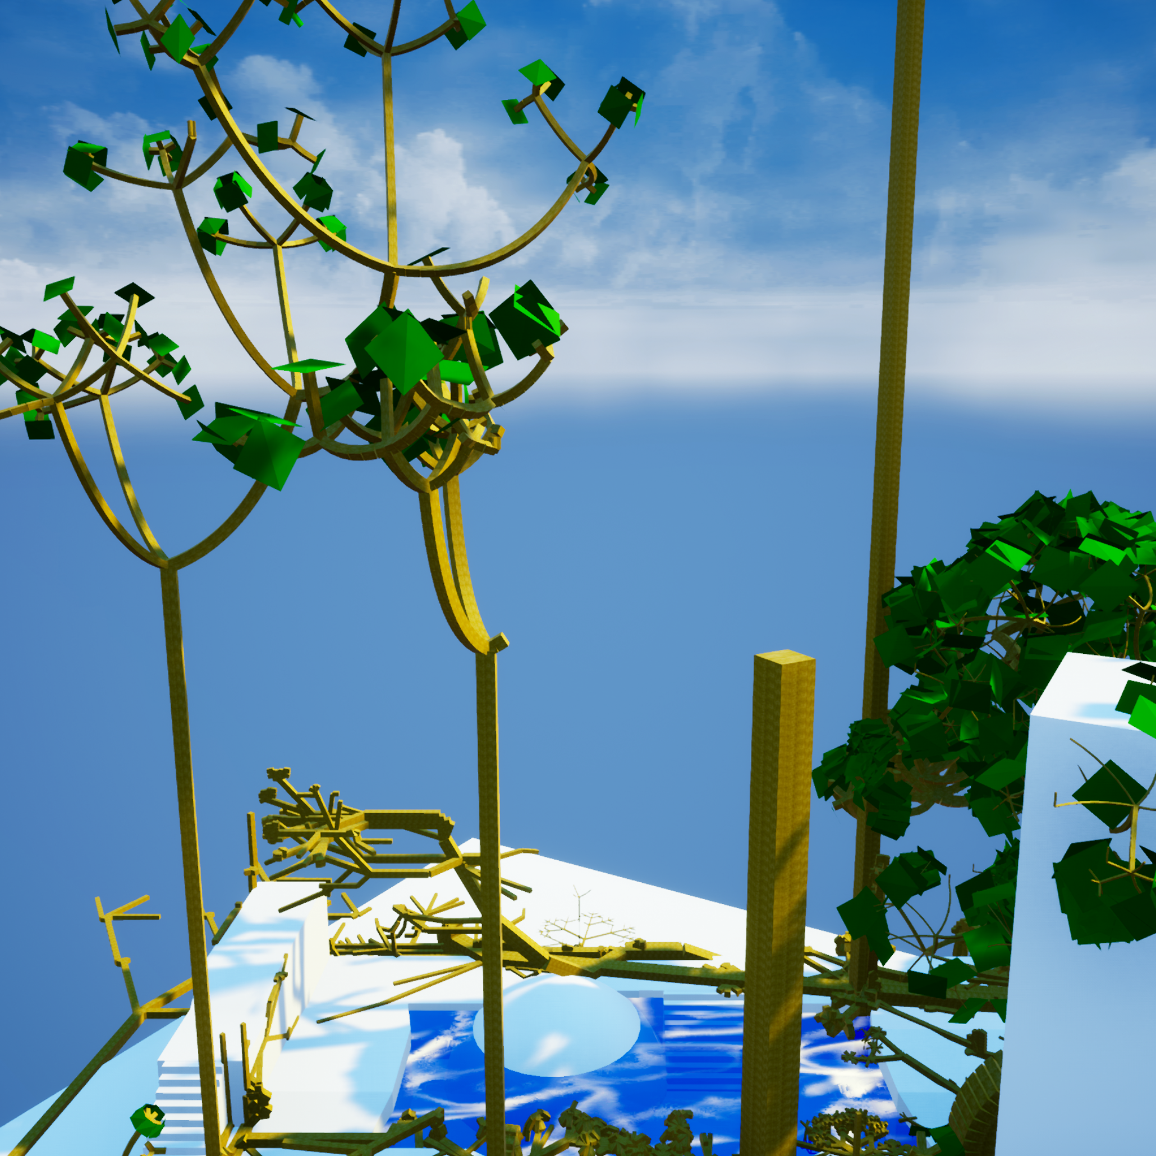
Wind
Wind is another important influence that defines biological growth of plants
This was modelled by Raytraces that put “wind weight” on hit cells, destroying them if over a threshold
Initially the system was designed to make damaged branches fall down by gravity
Unfortunately, Unreal does not support physics for non-static InstancedStaticMeshes

Slide 23
RESULTS???

Slide 24
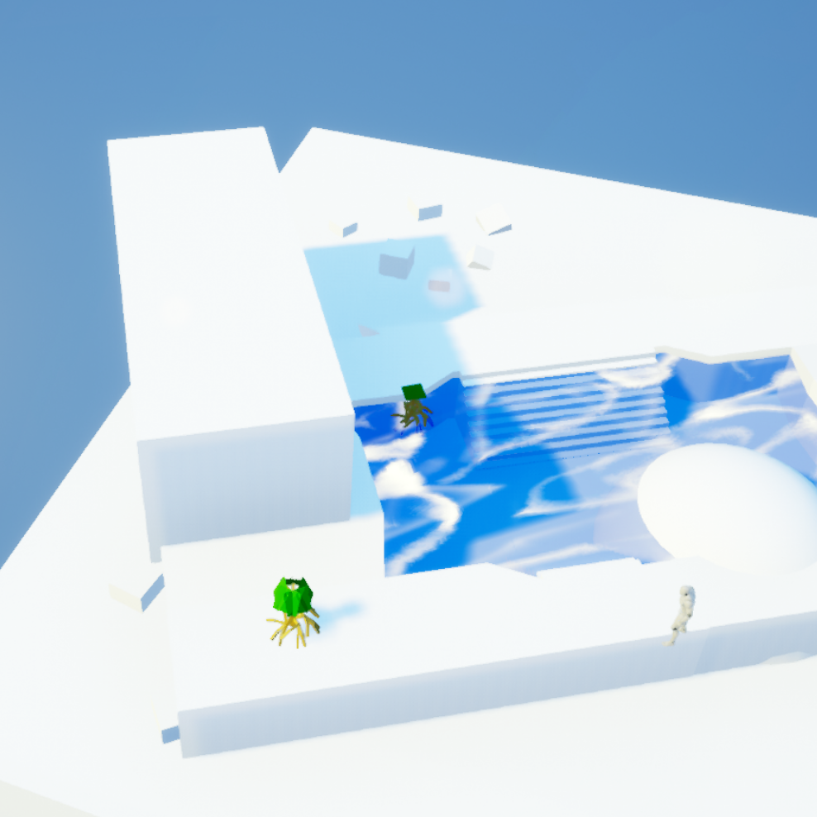
Comparison: Tree-Growth
The tree in the front (A) is close to the light
The tree in the back (B) has access to water
A reaches max cell count earlier, and builds a broader tree crown
B grows higher
10 Iterations

Slide 25
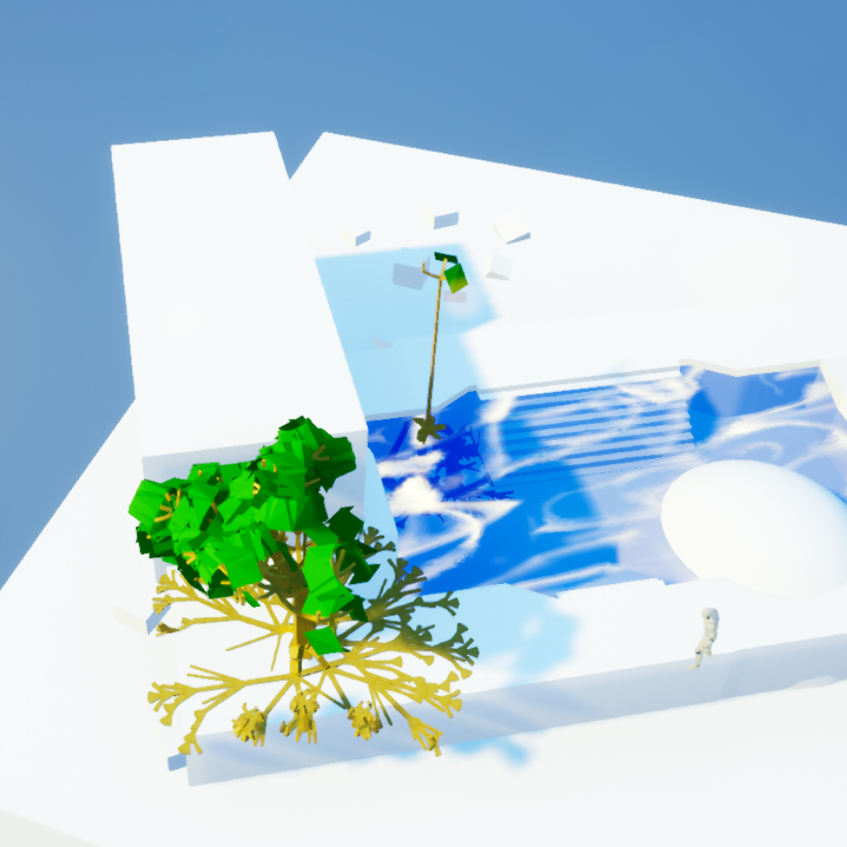
Comparison: Tree-Growth
The tree in the front (A) is close to the light
The tree in the back (B) has access to water
A reaches max cell count earlier, and builds a broader tree crown
B grows higher
30 Iterations

Slide 26
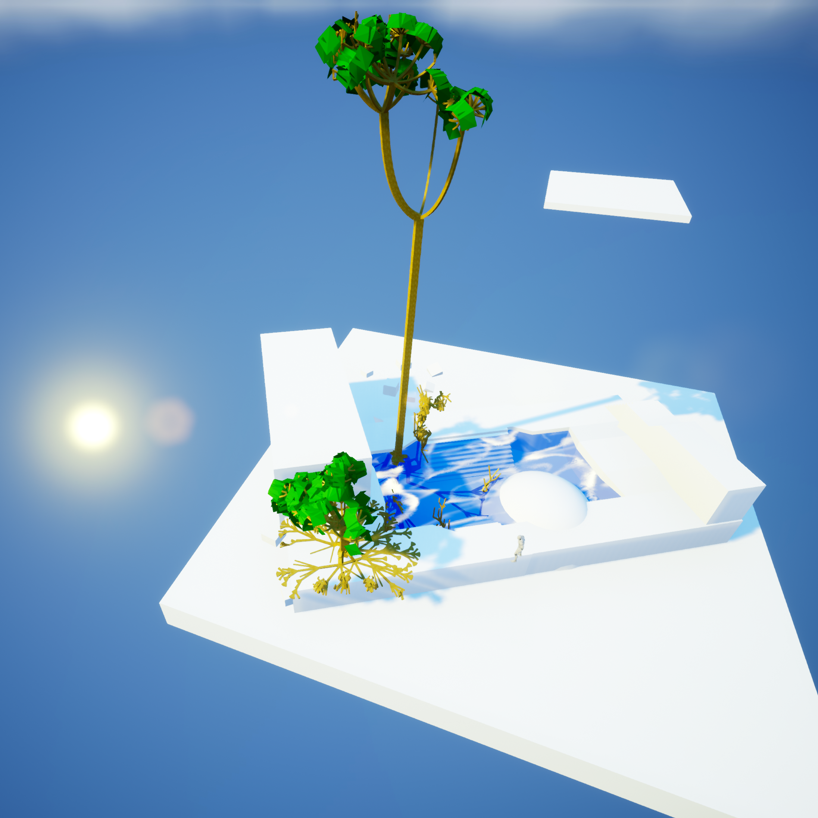
Comparison: Tree-Growth
The tree in the front (A) is close to the light
The tree in the back (B) has access to water
A reaches max cell count earlier, and builds a broader tree crown
B grows higher
45 Iterations

Slide 27
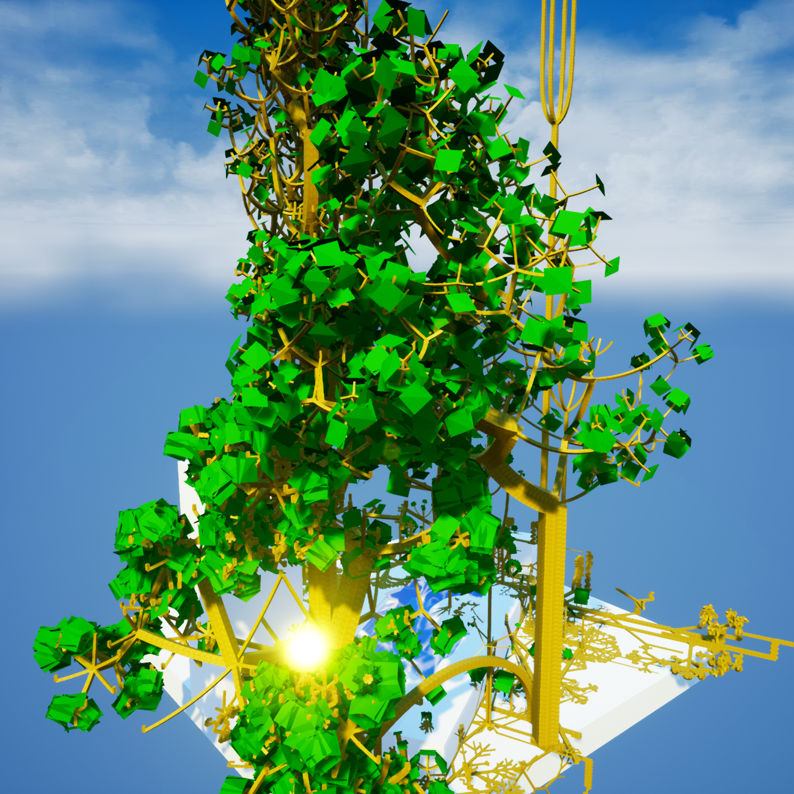
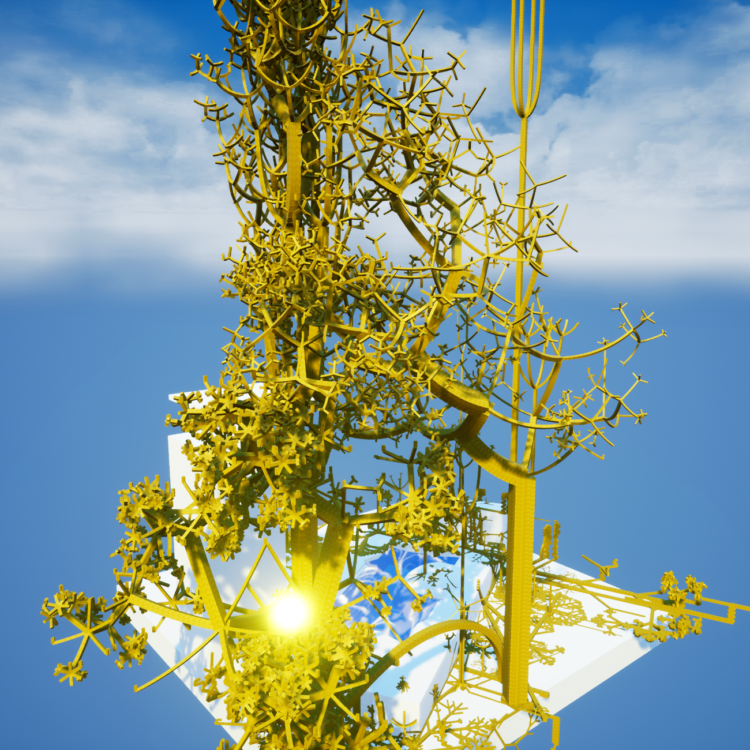
Comparison: Leafs Visible and Hidden

Slide 28
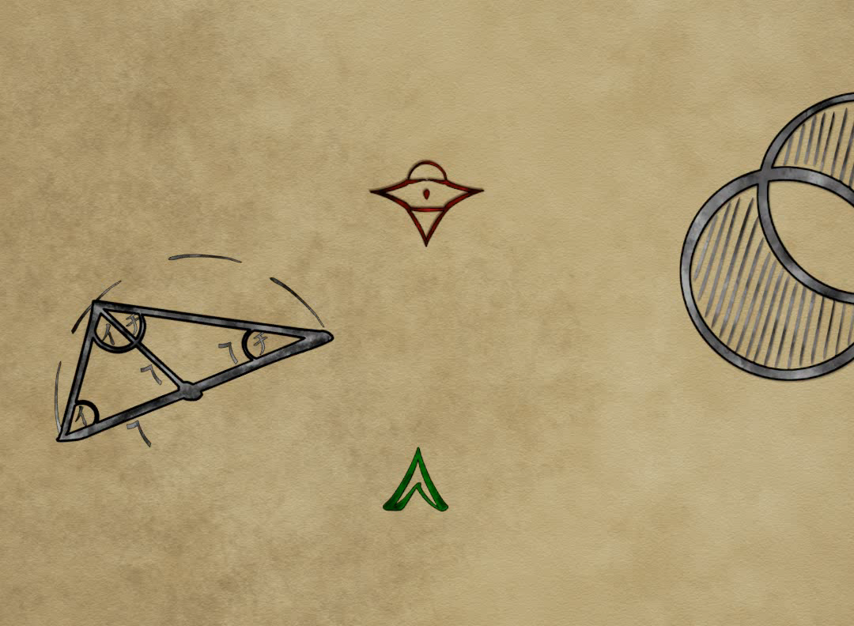
Program Features and Controls
One map where exact values for a plant can be set
One map that renders many plants at once (a “forest)
Character Control by industry-standard WASD/mouse
Jumping and flying by Space
I rerenders the single tree, and adds ten iterations for the forest
M switches Maps
P toggles leaf rendering
O rerandoms the tree and resets the forest

Slide 29
Performance: Iteration Subtask Times
GPU: Nvidia GTX 760
CPU: Intel i5-4670K 3.40GHz
When not growth iterating, the program always hits 60 fps
Iteration time and distribution on subtasks varies greatly

Slide 30
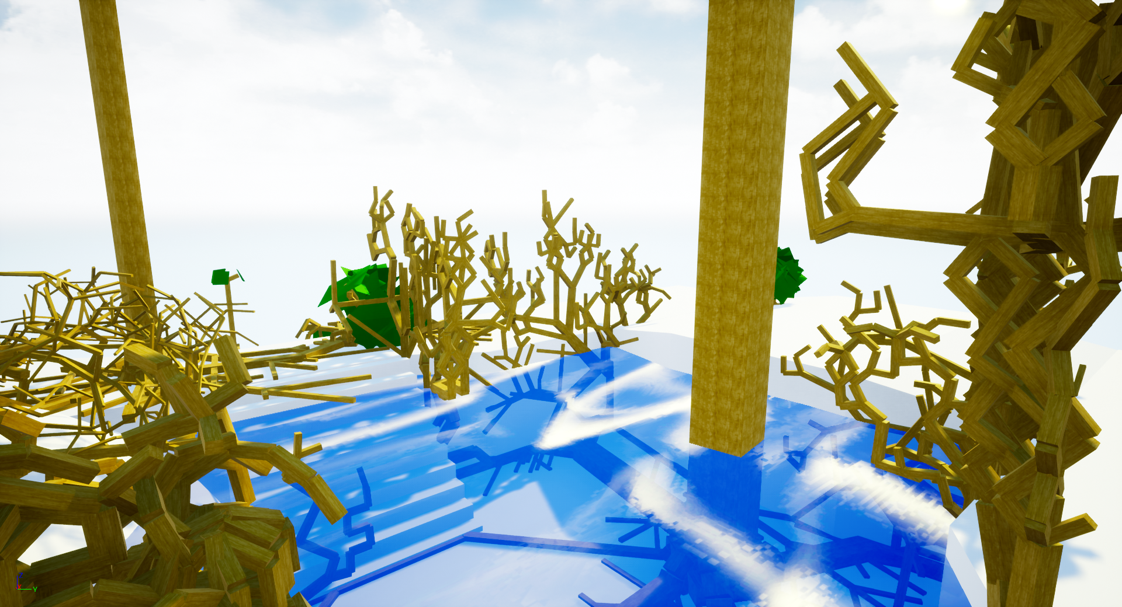
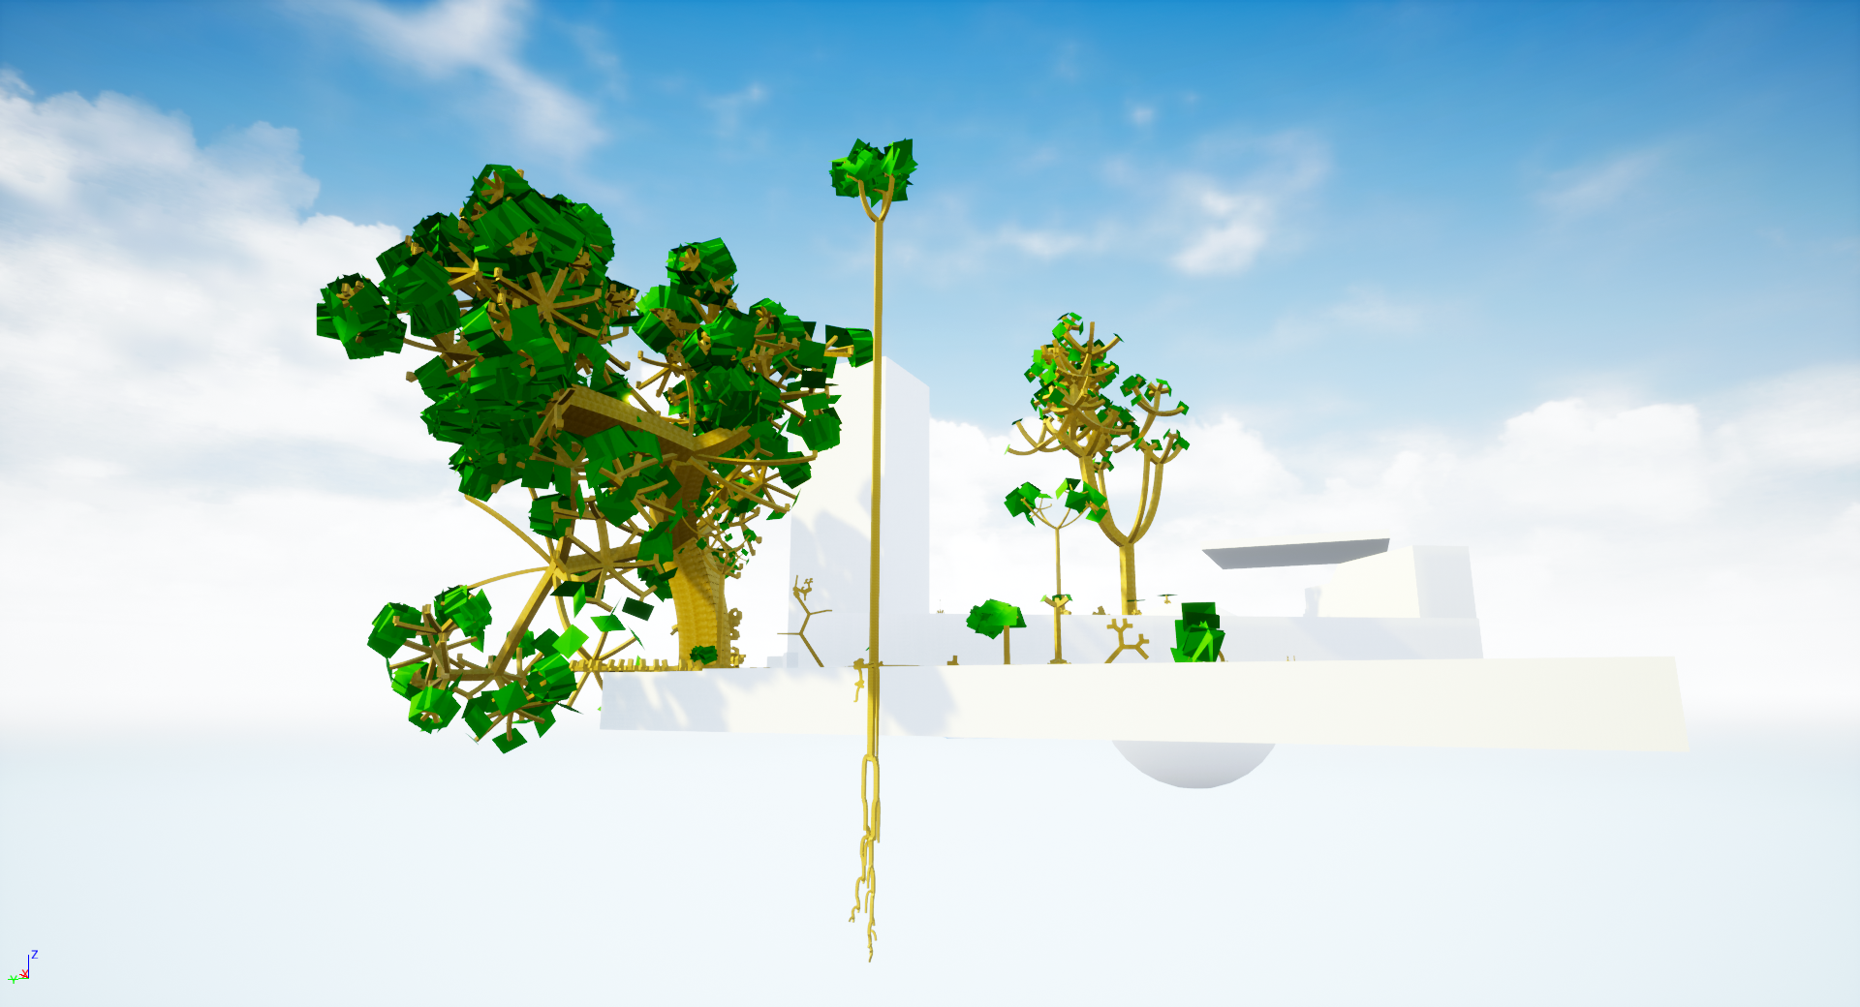
Impressions: Roots

Slide 31
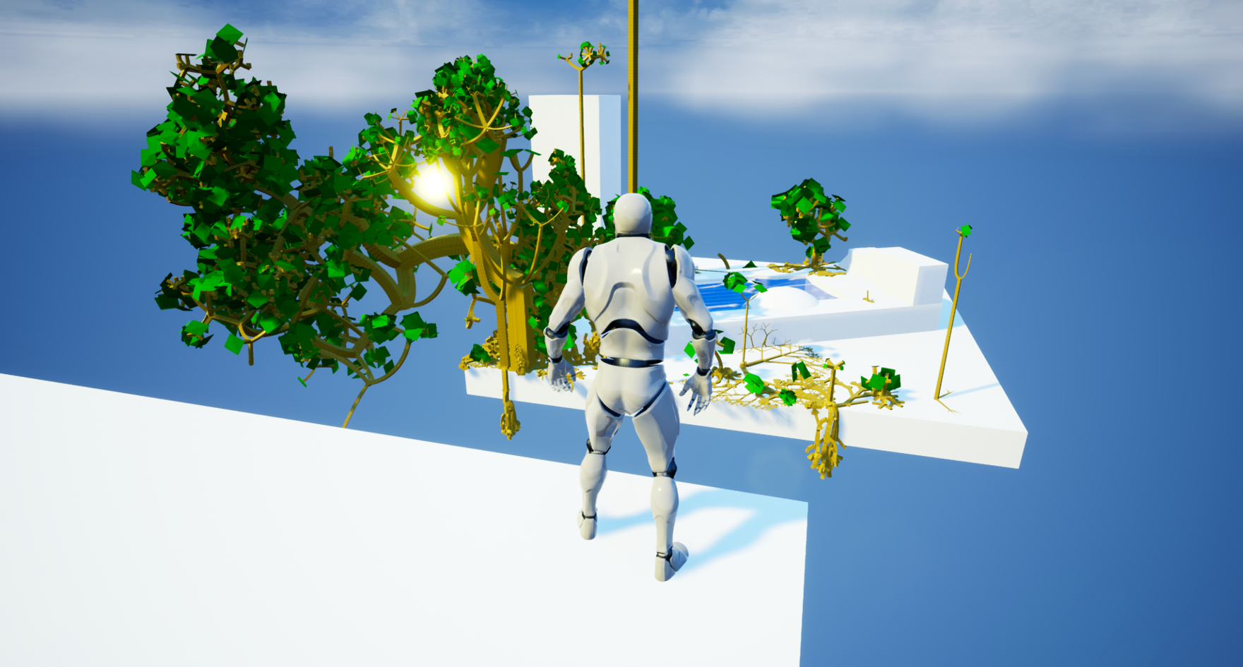
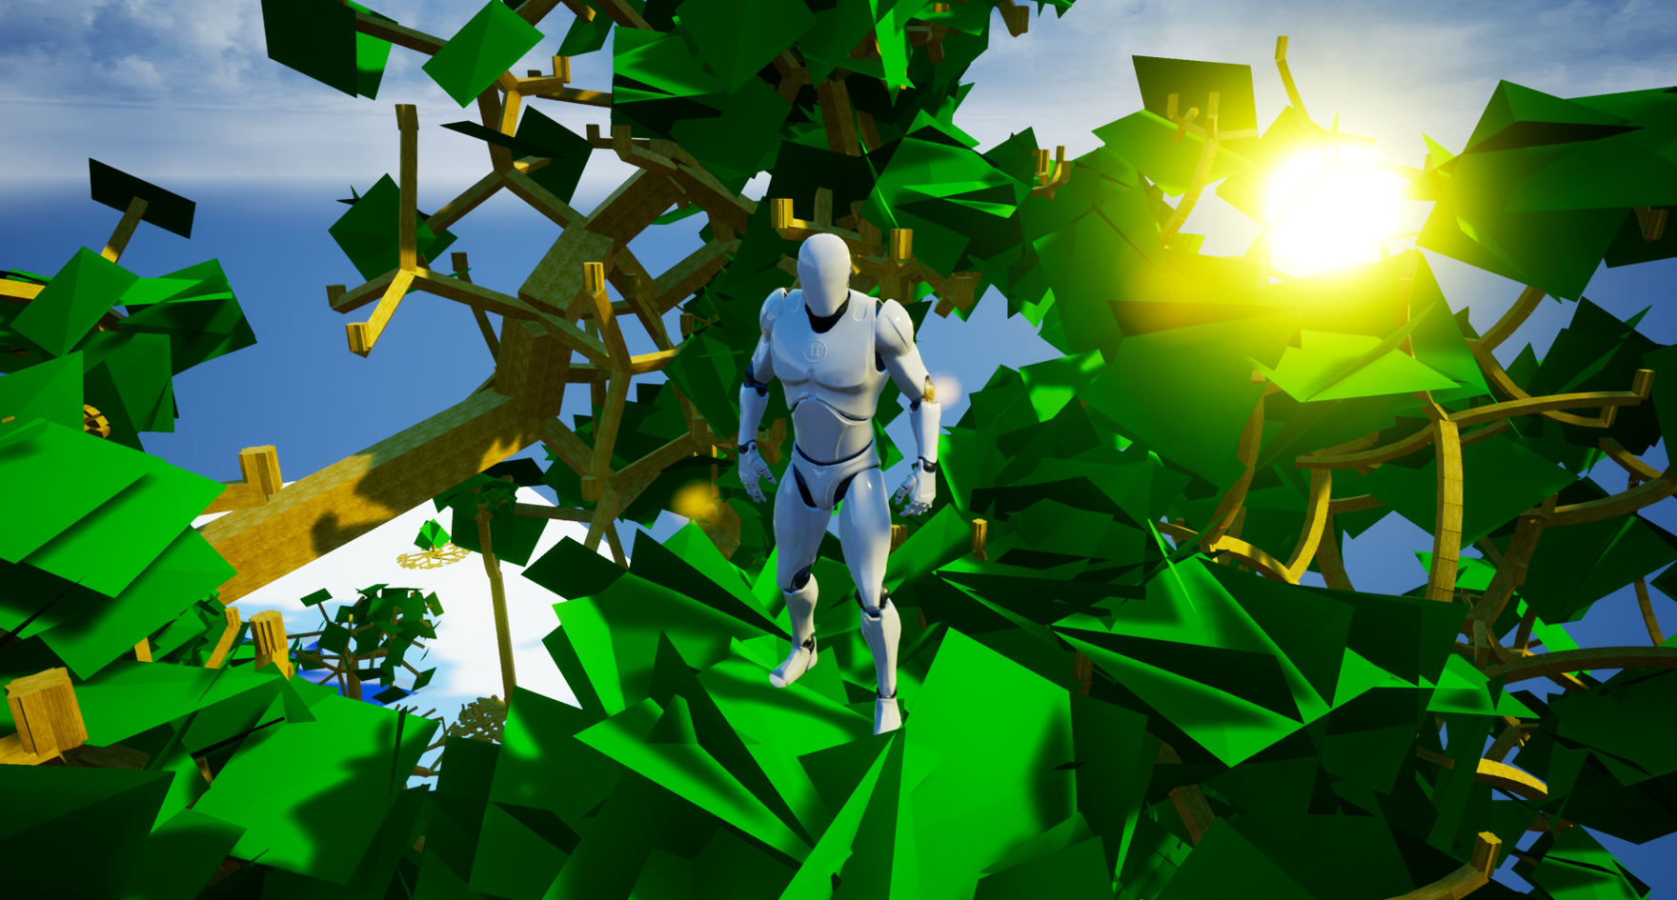
Impressions II: With Player Character

Slide 32
Going Forward
Simulated Ecosystems
This work constitutes a basis to simulate ecosystems
For example, further work could include nutrient circulation
This would require periodic plant death, and decomposers to return nutritients
Later, completely differently structured organisms („animals“) could be added
Even Spread and Self-Similarity
The possbilities of the plant description model were only scratched on the surface
Current Algorithms yield unsatisfactory results for non-circular degrees of freedom
Other plantal objects (e.g., blossoms) could be recreated with the model
The model could also be extended to allow non-punctiform origins (e.g., for pine cone shaped behavior)

Slide 33
Thank you for your attention. Any Questions?

